Slide 1
EQ: How does depreciation relate to compound interest?
Topic: Interest

Slide 2
Depreciation
Depreciation is a practise where businesses reduce the value of a good to pay less capital gains tax.
Depreciation works much he same as compound interest, but operates to reduce an items value by a percentage each year.
The big question- “If an item is depreciated by 20% each year, will it ever become worthless?”

Slide 3
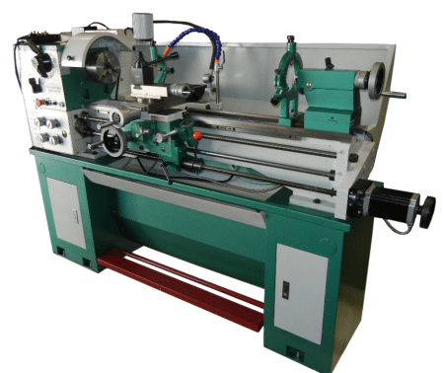
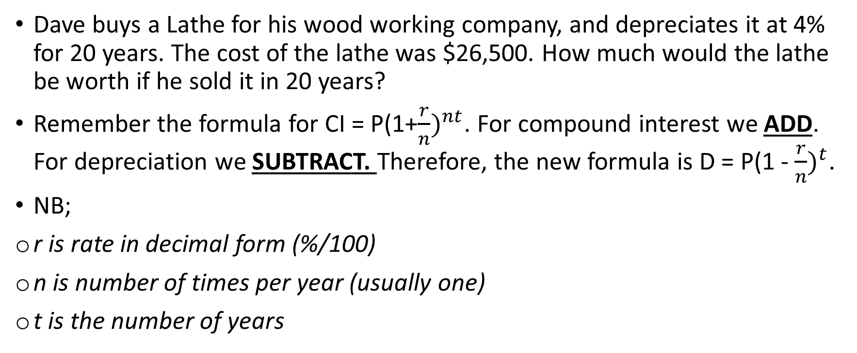
Depreciation in practise
Dave buys a Lathe for his wood working company, and depreciates it at 4% for 20 years. The cost of the lathe was $26,500. How much would the lathe be worth if he sold it in 20 years?
Remember the formula for CI = P(1+$\frac{r}{n})^{nt}$. For compound interest we ADD. For depreciation we SUBTRACT. Therefore, the new formula is D = P(1 - $\frac{r}{n})^{t}$.
NB;
r is rate in decimal form (%/100)
n is number of times per year (usually one)
t is the number of years
Notes:
a machine for shaping wood, metal, or other material by means of a rotating drive w

Slide 4

Depreciation in practise
D = P(1 - $\frac{r}{n})^{t}$.
Sub in values
D = 26500(1 - $\frac{0.04}{1})^{20}$.
D=11713.0645 ~$11,713.06
The lathe would be worth the above amount after 20 year depreciating at 4%

Slide 5
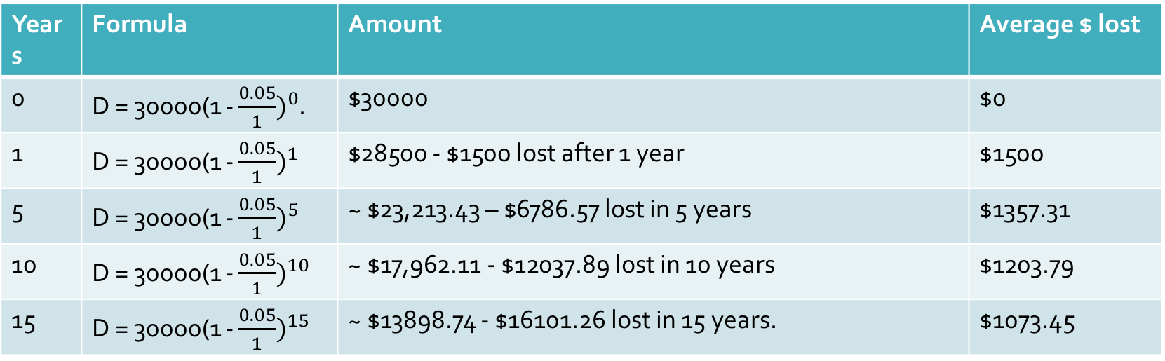

How does it work across time
Using a $30,000 brand new car, which depreciates at 5% per year, lets look at these effects at 1,5,10 and 15 years.
D = P(1 - $\frac{r}{n})^{t}$.
D = 30000(1 - $\frac{0.05}{1})^{YEARS}$.
Years | Formula | Amount | Average $ lost
0 | D = 30000(1 - $\frac{0.05}{1})^{0}$. | $30000 | $0
1 | D = 30000(1 - $\frac{0.05}{1})^{1}$ | $28500 - $1500 lost after 1 year | $1500
5 | D = 30000(1 - $\frac{0.05}{1})^{5}$ | ~ $23,213.43 – $6786.57 lost in 5 years | $1357.31
10 | D = 30000(1 - $\frac{0.05}{1})^{10}$ | ~ $17,962.11 - $12037.89 lost in 10 years | $1203.79
15 | D = 30000(1 - $\frac{0.05}{1})^{15}$ | ~ $13898.74 - $16101.26 lost in 15 years. | $1073.45

Slide 6
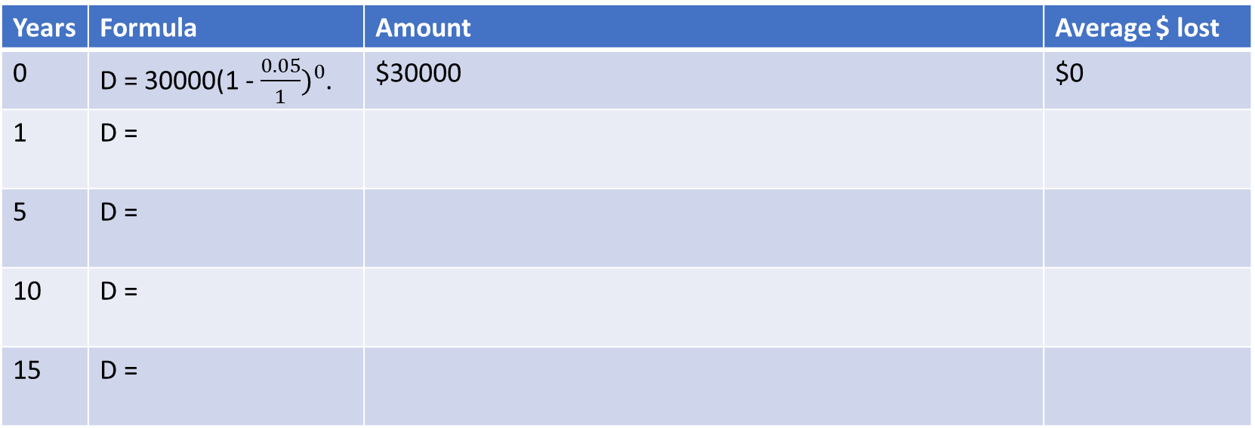
How does it work across time
Using a $30,000 brand new car, which depreciates at 5% per year, lets look at these effects at 1,5,10 and 15 years.
D = P(1 - $\frac{r}{n})^{t}$.
D = 30000(1 - $\frac{0.05}{1})^{YEARS}$.
Years | Formula | Amount | Average $ lost
0 | D = 30000(1 - $\frac{0.05}{1})^{0}$. | $30000 | $0
1 | D =
5 | D =
10 | D =
15 | D =

Slide 7
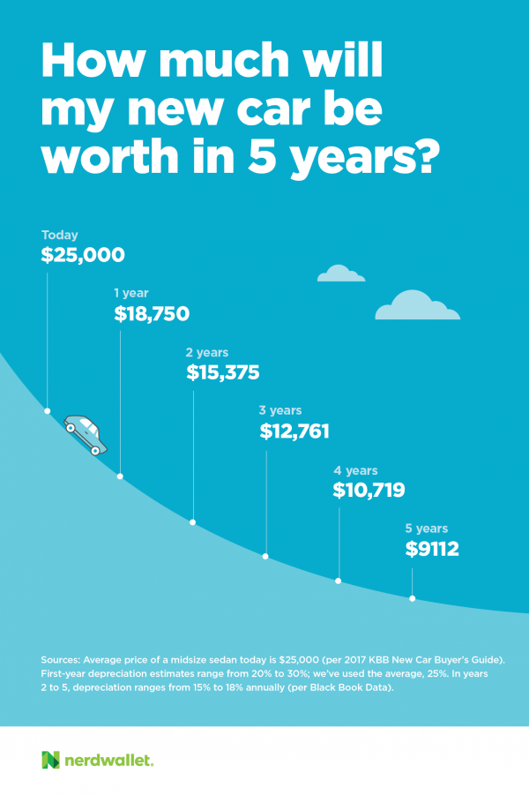
Key takeaway points
Depreciation is losing money across time
When an item depreciates, it loses less money each year because we only depreciate the new value, not just the first one.
With the car, if we kept losing $1500 every year, the $30,000 would be gone in 20 years, making the car worthless.
If all cars became worthless in 10 or 20 years, we would have massive junk yards and shortages of resources.

Slide 8
Key question
“If I depreciate something by 20% each year, will it ever become worthless?”- What do you think?
Would depreciation by simple interest create a worthless good?

Slide 9
Practise
Depreciate the following goods by the specified percentages
Principal | % | Times per year | Number of years | End Amount
$36,000 | 12 | 1 | 10
$10,000 | 5 | 1 | 6
$20,000 | 10 | 12 | 5
$100,000 | 5 | 365 | 0.5

Slide 10
Answers
Principal | % | Times per year | Number of years | End Amount
$36,000 | 12 | 1 | 10 | $10,026.04
$10,000 | 5 | 1 | 6 | $7350.92
$20,000 | 10 | 12 | 5 | $19,180.44
$100,000 | 5 | 365 | 0.5 | $99,312.71

Slide 11
Complete notes sheet for investigation and test on INTEREST
THESE ARE YOUR LAST 2!!!!

